Slide 1
Sprint 5 Demo
Tuesday, June 28th, 2022

Slide 2
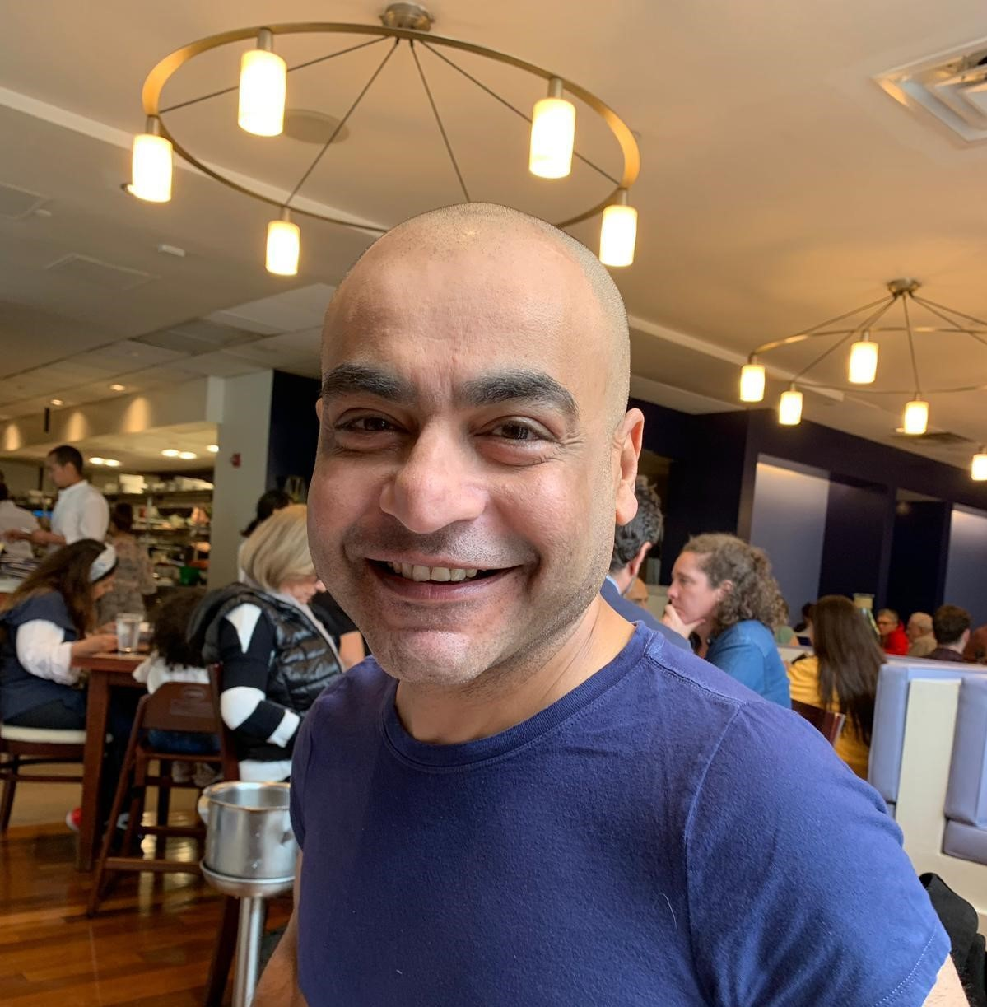
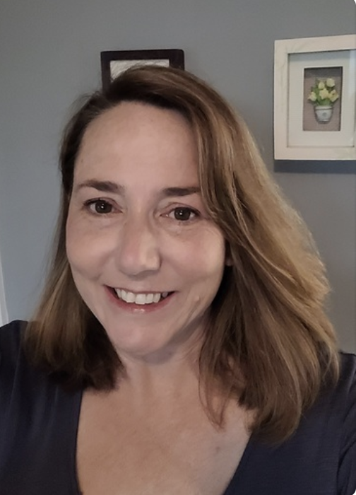










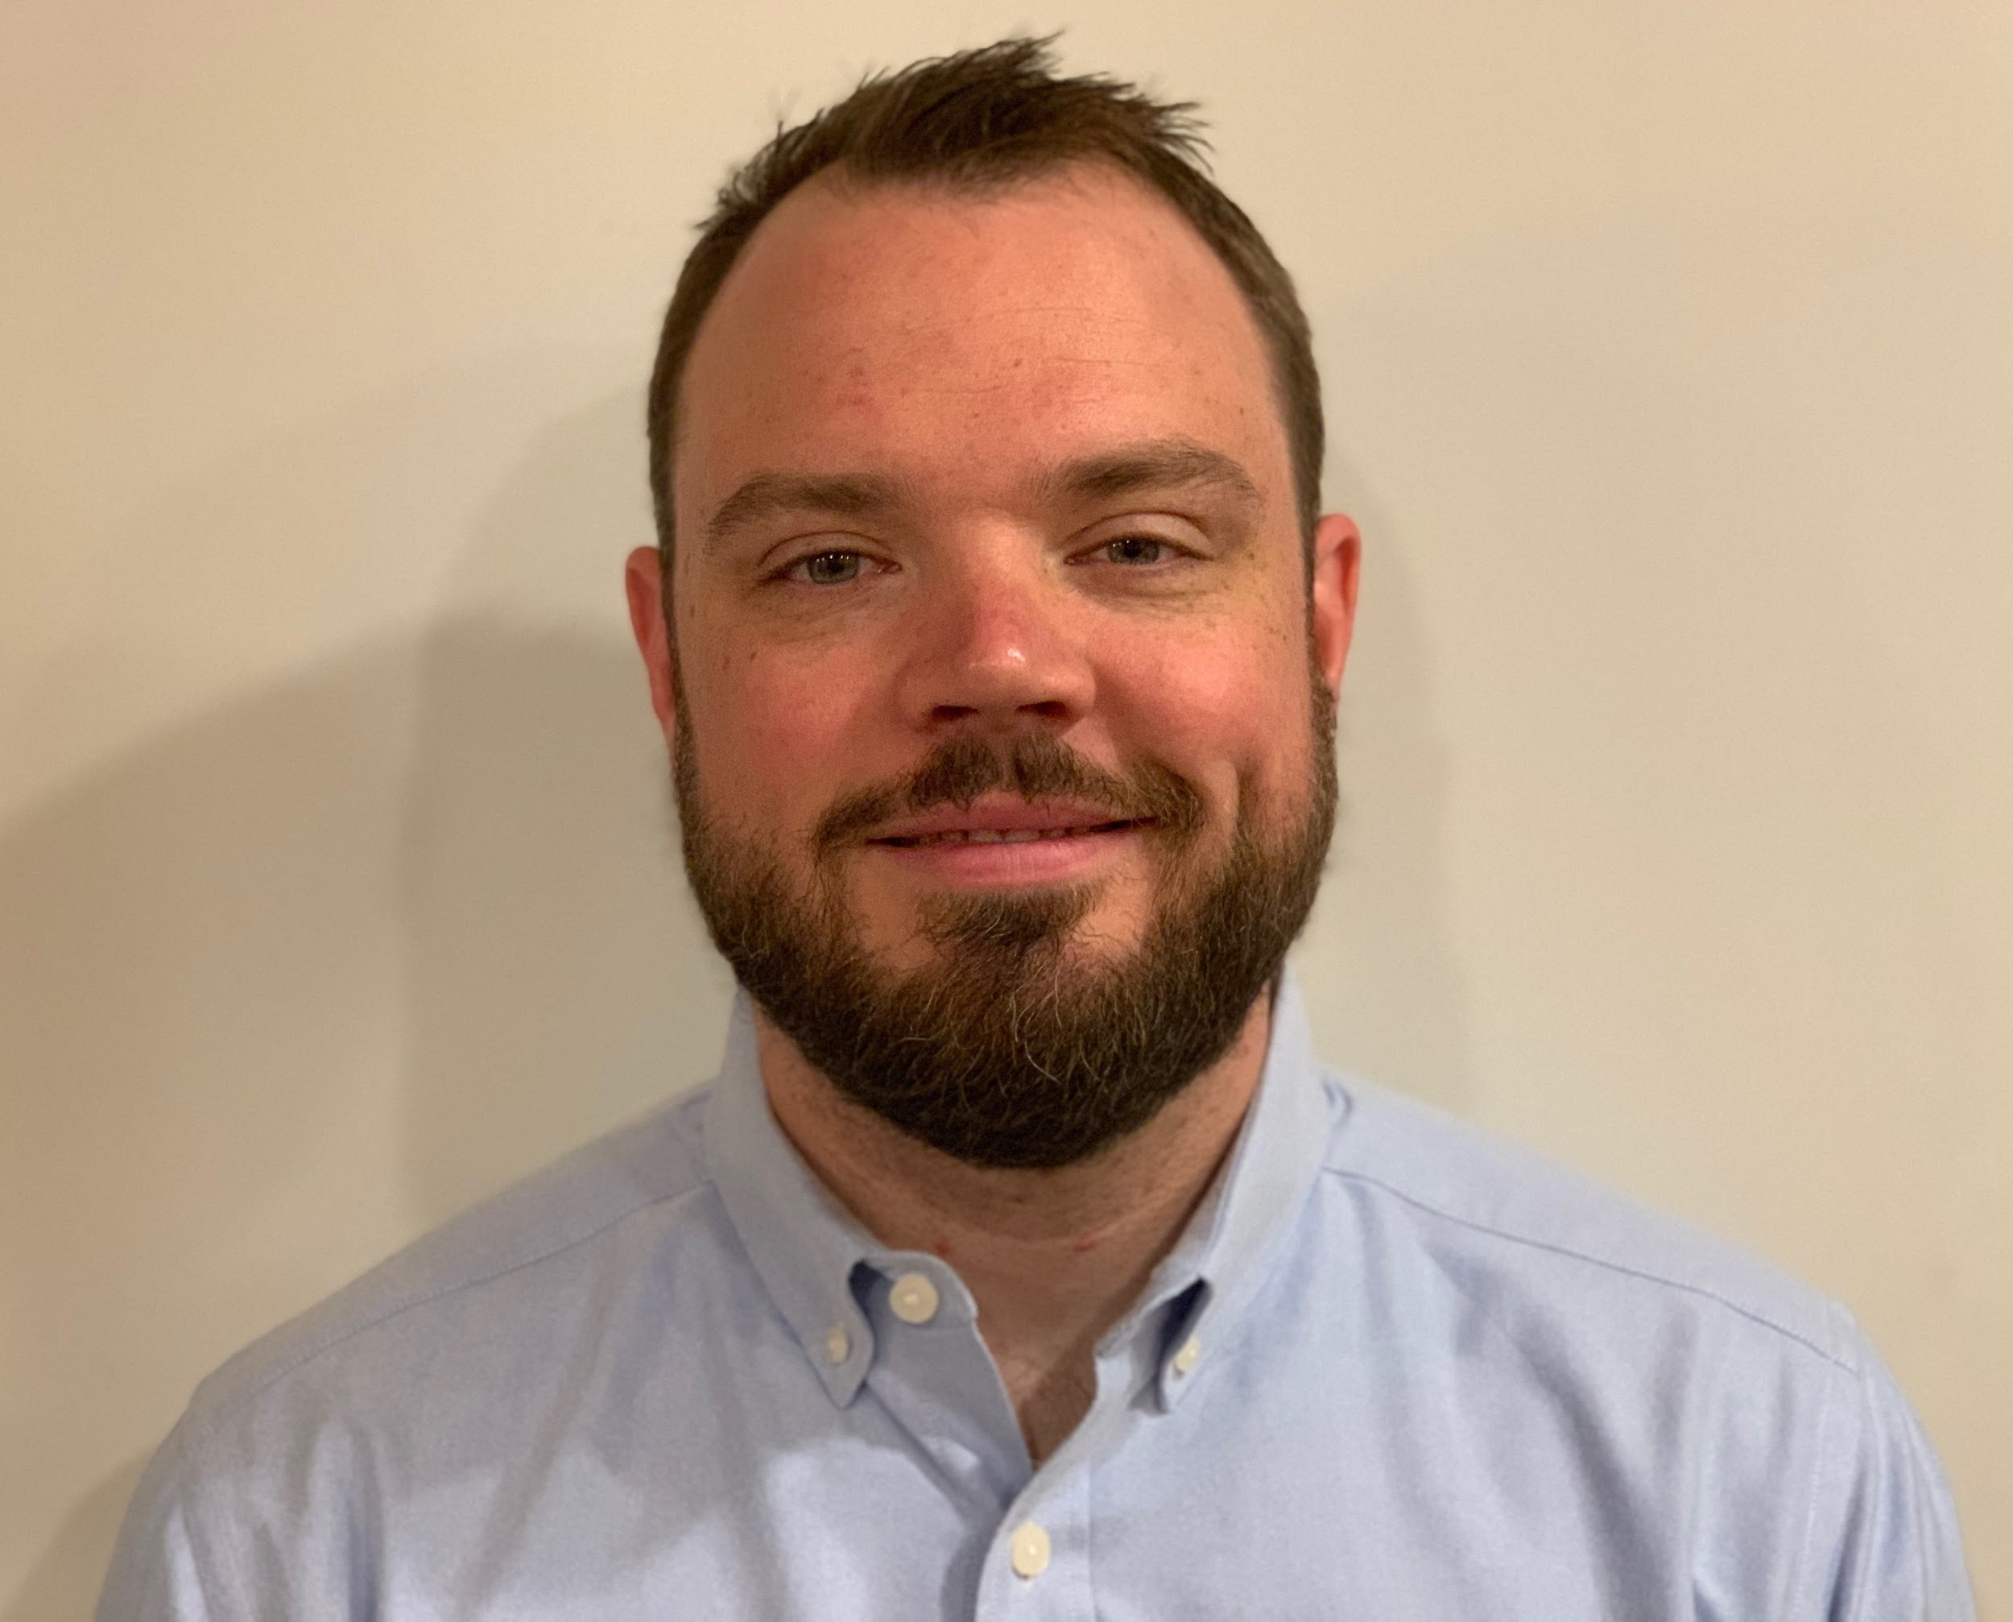
Get to know the team
Core team
Executive team
PRODUCT
ENGINEERING
Munish Sikka
Washington DC
Product Lead
Tami Corson
North Carolina
Clinical SME / Scrum
Shashank Khandelwal
Rockville, MD
Tech Lead
Jeff Scheire
MO Studio
Marcy Jacobs
McKinsey & Co
Kevin London Frog Design
DESIGN
Thomas McCue Oak Park, IL Principal Designer Director
Carl Dickerson Atlanta, GA Content Strategist and Plain Language Content Creator
Carolyn Williams Chicago, IL Experience Designer
Teagan Stephenson
Ft. Lauderdale, FL
Full Stack Engineer
1095-B Product Only
Will Reynolds SERVE Advisory
Ben Morris
Pluribus Digital
Travis Hoffmann
MO Studio
06-28 Sprint 5 Demo
Introduction

Slide 3



At the end of each sprint on Tuesdays, the team will run sprint reviews to showcase the sprint’s work for approval. The purpose of this meeting is:
WELCOME TO THE SPRINT 5 DEMO
1
To demo the accomplishments or functionality that was built over the past sprint
2
To get feedback and insights early and often
3
To create transparency for anyone interested on the product and progress
06-28 Sprint 5 Demo
Introduction

Slide 4
CEDAR TO1 Overview
WE ARE HERE
PHASE
CY 2021
CY 2022
SPRINT
0
1
2
3
4
5
6
7
8
9
10
11
12
13
14
15
16
17
18
19
20
21
22
23
24
25
MONTH
Sep
Oct
Nov
Dec
Jan
Feb
Mar
Apr
May
Jun
Jul
Aug
Sep
DHM - Health Apartment
FOCUS
1095-B Form
Follow ups as needed
Community Care
Health Hub
06-28 Sprint 5 Demo
Introduction

Slide 5
Agenda
Sprint Goal:
For sprint 5 for Health Hub we focused initial synthesis of Veteran usability of IA hypotheses and expanded caregiver participation, made prototypes of possible IA’s representing hypotheses.
On 1095-B we conducted accessibility testing and discovery with MVP, conducted legal research on opt-in requirements and collaboratively designed opt-in, planned for notifications, and presented product updates and designs to HEC Business owner for approval.
HEALTH HUB
IA tree test synthesis – Veterans’
1095-B
Solution for MVP 508 accessibility -mockups / text
Designed opt-in element for approval by Business Owner - sketch
Preparation of HEC legal review- notification build
 | We welcome all feedback! Feedback will be collectively reviewed and prioritized appropriately based on where it stacks against other stories in the backlog as well as technical feasibility.
06-28 Sprint 5 Demo
Agenda

Slide 6
Health Hub
SPRINT 5 DEMO
06-28 Sprint 5 Demo

Slide 7



Health Hub Workplan v4
Owned by design team
Owned by product team
WE ARE HERE
SPRINT 1
4/20 – 5/03
SPRINT 2
5/04 – 5/17
SPRINT 3
5/18 – 5/31
SPRINT 4
6/01 – 6 /14
SPRINT 5
6/15 – 6/28
SPRINT 6
6/29 – 7/12
SPRINT 7
7/13 – 7/26
SPRINT 8
7/27 – 8/09
SPRINT 9
8/10 – 8/23
SPRINT 10
8/24 – 9/6
Kickoff
Build understanding of product and product goals
Build Roadmap
Product & Delivery
Build initial workplan and backlog
Business partner discovery
Prototyping
Prototype Research
User Experience & Design
Comparative research
Consolidate existing research
Experience Map
Potential Second Prototype Research
Current state mapping
Research Activities Plan (RAP)
Final Recommended Prototype
IA Tree Test Plan H0 & H1
Final IA Recommendations delivered
Engineering & Development
Tech Discovery
Tech Feasibility
06-28 Sprint 5 Demo
Workplan

Slide 8
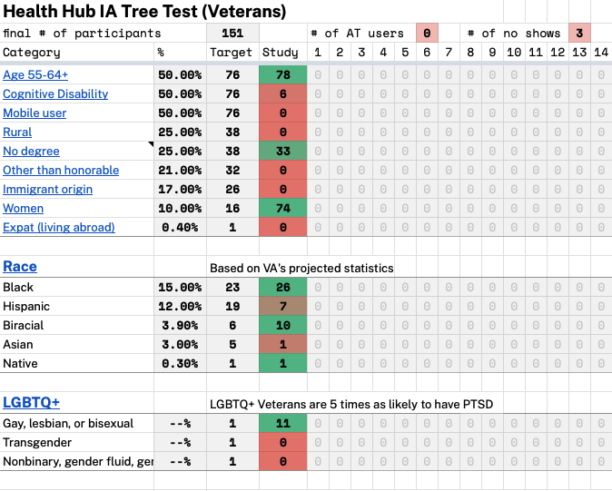
A
IA tree test synthesis – Veterans’ initial findings
User Story: Continue to monitor IA treejack test
User Story: Submit for additional caregiver cohorts
User Story: Conduct research synthesis—Veterans
Initial findings
Hypothesis 1 performed better on “get” tasks
Hypothesis 0 performed better on “manage” tasks
For participants without VA health care, Hypothesis 1 performed better
For both hypothesis, Task 9 had the highest success rate
Task 5 had the lowest success rate for both hypotheses
Link
06-28 Sprint 5 Demo
Health Hub
8
Notes:
Carolyn

Slide 9
1095-B Status Update
SPRINT 5 DEMO
06-28 Sprint 5 Demo

Slide 10

1095-B Workplan v7
Owned by design team
Owned by product/ engineering team
Release
WE ARE HERE
SPRINT 7
4/20 – 5/03
SPRINT 8
5/04 – 5/17
SPRINT 9
5/18 – 5/31
SPRINT 10
6/01 – 6 /14
SPRINT 11
6/15 – 6/28
SPRINT 13
6/29 – 7/12
SPRINT 14
7/13 – 7/26
SPRINT 15
7/27 – 8/09
SPRINT 16
8/10 – 8/23
SPRINT 17
8/24 – 9/6
1095-B: Spanish translation docs
1095-B: Spanish translation opt-in docs
Turnover document of remaining post-MVP work (VA notify, 2022 IRS form, 508 compliance, multiple year selection)
1095-B: Legal Review
1095-B: Legal Review – Opt-in
Product & Delivery
VA 508 Assistance request
Kickoff
Align on launch MVP v. MVP w/ opt-in
User Experience & Design
Design for opt-in
Launch communication plan
Notification flow
Design for MVP 508 accessibility
1095-B Wayfinding
Tech feasibility opt-in build
Tech feasibility wayfinding
Engineering & Development
Build for opt-in / 508
Build for wayfinding
Build Analytics for launch monitoring
Collaboration Cycle
1095-B Launch
1095-B Post launch evaluation
Sitewide and Content IA ticket
Call center review
06-28 Sprint 5 Demo
Workplan

Slide 11
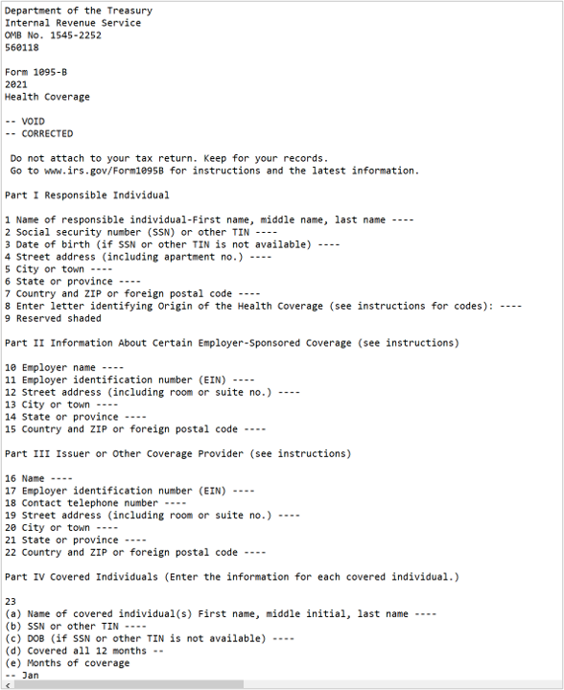
A
508 Accessibility Analysis
User Story: Trial run populated IRS 1095-B from widget w/ screen reader
User Story: PM to f/u on VA 508 accessibility support ticket
User Story: Conduct discovery into alternate forms of IRS 1095-B
Team reviewed populated 1095-B document with screen reader technology:​
Blank PDF from IRS - Passed​
Flat data - Failed​
Non-flatten data - Failed​
Form without privacy data - TBD​
​
Options to investigate:​
Use text version of 1095-B (discussion on next page)​
Offer PDF and text options​
Have IRS build 1095-B HTML​
Fix privacy data, if issue, and continue with 1095-B as built
1095-B Text version
06-28 Sprint 5 Demo
1095-B
11
Notes:
Carl

Slide 12
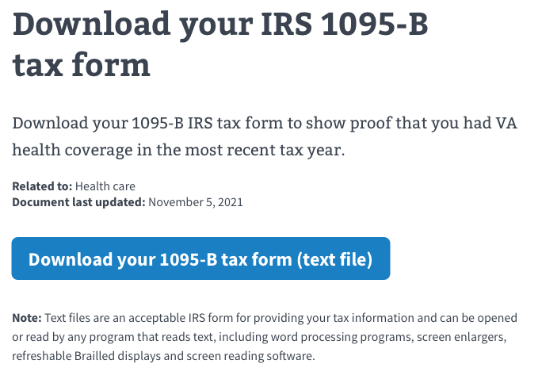
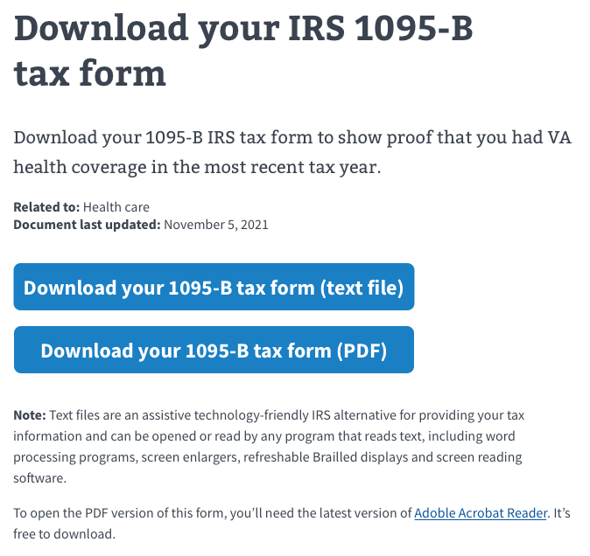
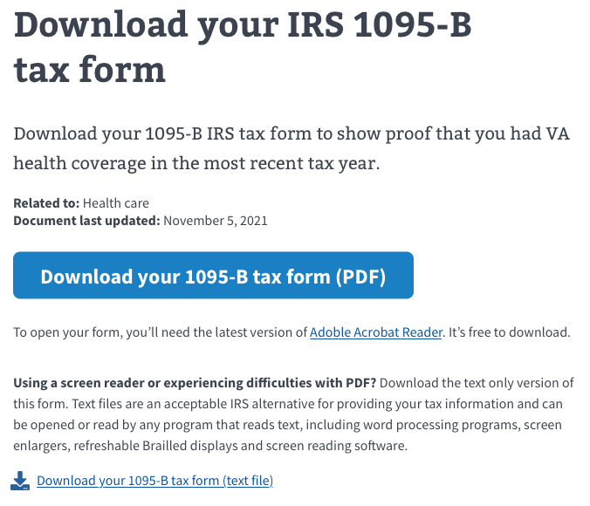
A
Solutions for MVP 508 accessibility
1
User Story: Create mock-ups of potential 508 solutions using various combinations of text / PDF for review w/ VA-PO
3
Options to solve for PDF inaccessibility:
​
Change output of widget to text version only and amend content to express that output of current widget would be text version of 1095-B ​
Expand current widget with second primary button and content for downloading text version of 1095-B​
Build a second widget / content for sight deficient to upload text version of 1095-B​
2
1095-B Sketch file​
06-28 Sprint 5 Demo
1095-B
12
Notes:
Carl

Slide 13
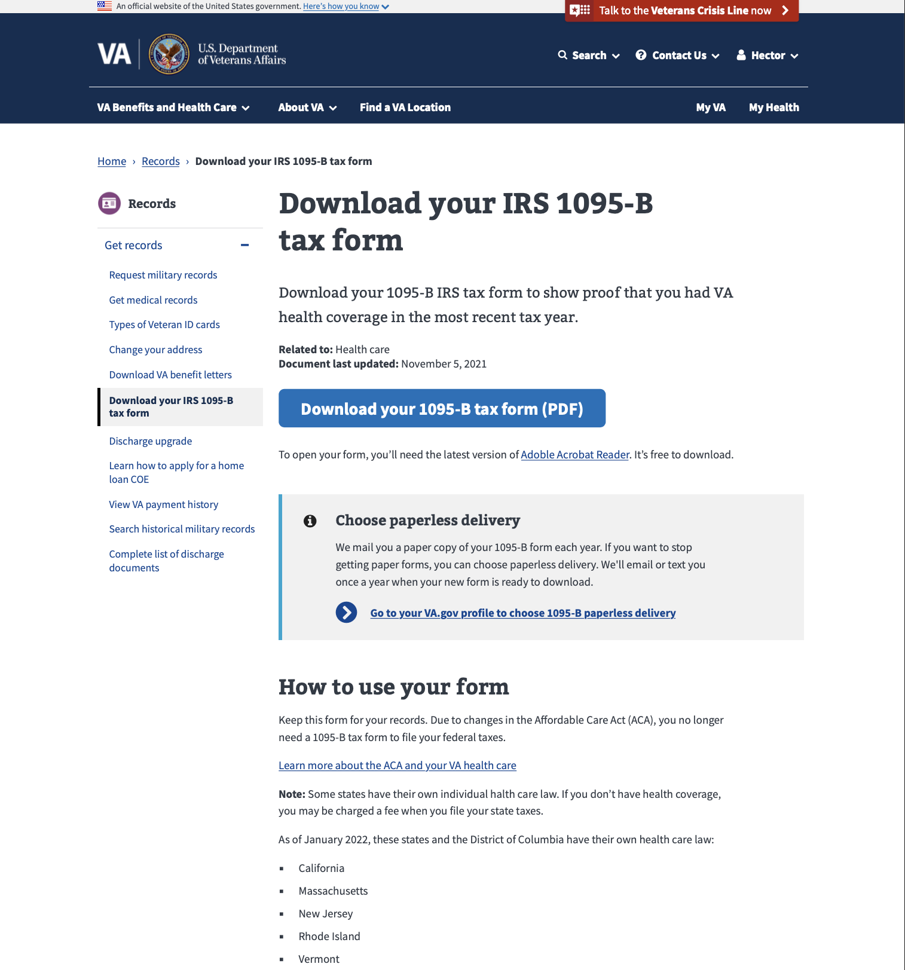
B
Opt-In Design Element
User Story: Review new design component - opt-in {1095-b / VA Profile
User Story: Iterate on opt-in designs based on feedback
User Story: Seek approval of final opt-in design from Business Owner
User Story: Iterate on HEC documents to reflect approved otp-in design component
User Story: Update call center documents to reflect approved opt-in design
Design Update
Some minor edits to copy have been made
“Information Alert Box” component deemed the appropriate component for use in this case.
“Go Paperless….” copy determined to be effective and appropriate language.
Placed immediately below document download element to reinforce association with that action
View in Sketch
06-28 Sprint 5 Demo
1095-B
13
Notes:
Thomas

Slide 14
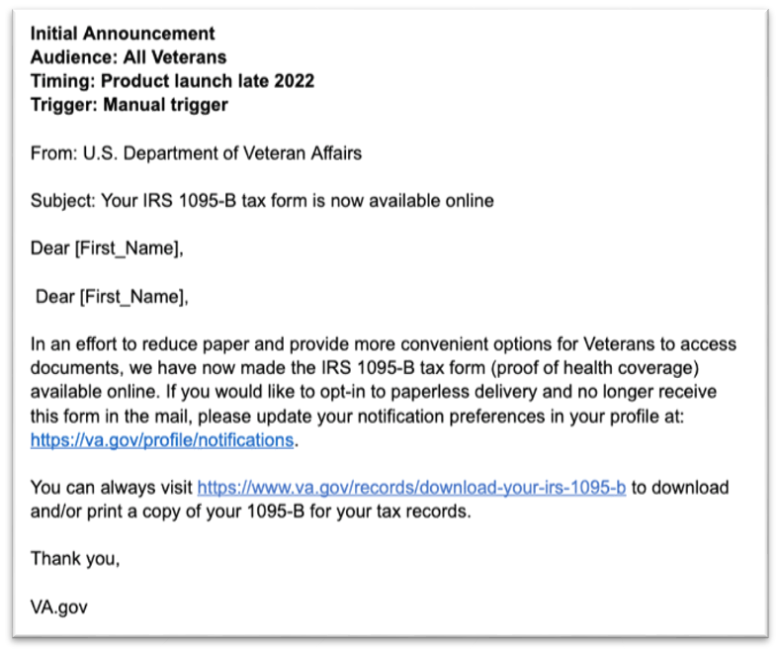

C
Initial Announcement for Enrollment
User Story: Build process map for 1095-B opt-in notifications
User Story: Discover what is needed for opt-in legal review
Initial Notification:
“Blast” email notification​
Manual trigger by 1095-B Team or HEC​
Manual trigger yet to be built
Notification letter content created and build into VA Notify
06-28 Sprint 5 Demo
1095-B
14
Notes:
Munish

Slide 15
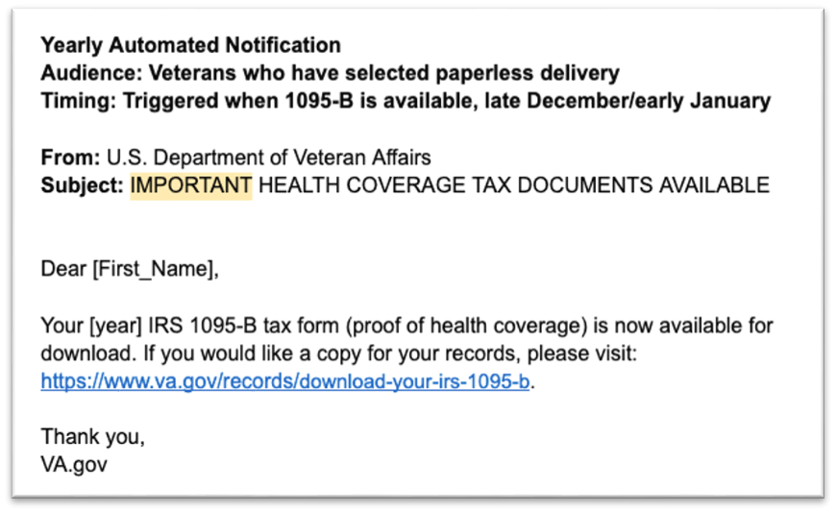
C
Yearly Automated Notification
Annual Notification:
Selective email to those who have opted in to email notifications​
Trigger to be built by 1095-B team to fire when new tax template uploaded​
Notification letter content created and built into VA notify by 1095-B team​
06-28 Sprint 5 Demo
1095-B
15
Notes:
Munish Preparation of HEC legal review- notifications / build triggers

Slide 16
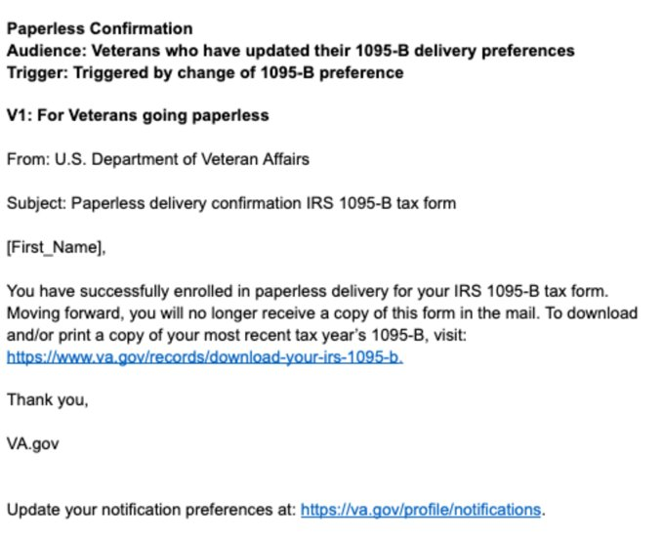
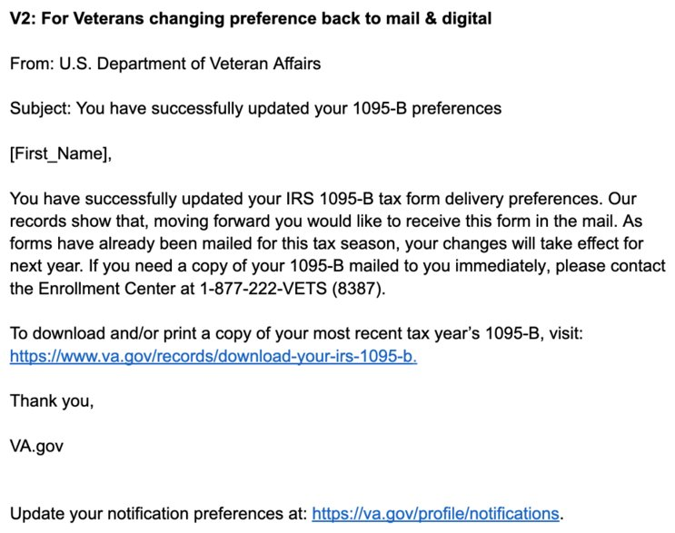
Opt-In & Opt-Out Notifications
Initial Notification for Opt-In:
Notification for Opt-Out:

Slide 17
Blockers for 1095-B launch
BLOCKER | OWNED BY | ACTION NEEDED | DATE ENTERED | STATUS | NOTES
Legal Review | Tarsha Tremble (Business Owner) | Business Owner is seeking a POC with the Office of General Counsel to understand requirements for legal review and timeline | Sprint 3 - 3/2/22 |  | MVP is approved, opt-in is still pending review
PDF Accessibility | Tarsha Tremble (Business Owner) | Team received PDF from IRS, but PDF is still not accessible once it is populated with data | Sprint 3 – 3/3/22 |  | Exception request denied, still awaiting assistance
Spanish Translation | Tarsha Tremble (Business Owner) | Follow up with translation progress of MVP materials | Sprint 7 – 4/20/22 |  | June 29 expected date
Spanish Translation | Tarsha Tremble (Business Owner) | Follow up with translation progress of opt-in materials | Sprint 11 – 6/14/22 |  | TBD
06-28 Sprint 5 Demo
1095-B Blockers

Slide 18
1095-B Remaining actions, with external dependencies
ITEM | WORK STREAM | ACTION NEEDED | TARGET COMPLETE DATE | PREREQUISITE
Launch | Product & Tech | Work with tech to create a vets-website release | End of June | VA 508 solution assistance
UAT | Product & Tech | Follow Collaboration Cycle guidelines for UAT Identify Veterans within VA to conduct UAT, send access, and follow up to ensure testing complete | TBD | Product dark launched
1095-B Opt-in | Product | Follow up with HEC and Profiles team to ensure 1095-B opt-in is done Follow up with Notifications team to ensure related SMS & e-mail notification flow is optimal Update draft communications and announcement plans, based on when opt-in will be launched | June - July | HEC and Profiles commitment to building opt-in
Notification Triggers | Design & Tech | Notification letters approved by legal Build triggers for opt-in, opt-out, annual update | July | Legal review
Legal Review | Product | Work with Tarsha to complete legal review for Opt-In | June – Aug | POC name from Tarsha
Post Launch Check- In | Product | Complete Collaboration Cycle milestone to KPIs post launch | TBD (One month after launch and announcement) | Product launched in prod
Links from VA.gov pages to 1095-B | Product & Design | Work with IA team to have other identified pages within VA.gov (e.g., ACA page) link to the 1095-B page Work with IA team to have 1095-B page added to navigation and be found in VA.gov search | June or later | Product launched in prod; aligned on comm plan with Tarsha, Tracey
1095-B update strategy | Product | Align on who will own 1095-B long term, including updating the PDF template each year | May or later | Product complete and launched in production
Communications to announce launch | Product & Design | Work with Tarsha and HEC team to refine drafted communications and align on plan and timeline to announce 1095-B launch to Veterans Work with VA Notify team to build and launch communications on their platform | October - December 2022 | Product launched in prod; aligned on communication plan with Tarsha/Tracey
06-28 Sprint 5 Demo
1095-B Remaining actions

Slide 19
Sprint Deliverables
SPRINT 5 DEMO
06-28 Sprint 5 Demo

Slide 20
Sprint 5 Deliverables – Health Hub
EPIC | STORY | ESTIMATE | ASSIGNED | OUTPUT | REVIEWED W/ VA-PO | SPRINT TEAM GOAL COMPLETED?
Research | #42887 Submit for additional caregiver cohorts with VA research & Perigean | 2 | Carolyn Tami | Additional cohort recruitment | 6/17/22 | ✓
Research | #42799 Continue to monitor IA teejack test (#1) | 2 | Carolyn | NR | 6/28/2022 | ✓
Research | #42886 Conduct research synthesis – Veterans (#1) | 13 | Carolyn Shashank | Design review deck Synthesis document | 6/23/2022 | ✓
06-28 Sprint 5 Demo
Sprint 5 Deliverables

Slide 21
Sprint 5 Deliverables – 1095-B (1 of 2)
EPIC | STORY | ESTIMATE | ASSIGNED | OUTPUT | REVIEWED W/ VA-PO | SPRINT TEAM GOAL COMPLETED?
Product | #40454 PM to f/u w/ VA-PO on HEC documents being translated into Spanish | 1 | Tami | NR | 6/28/2022 | ✓
Product | #39722 PM to f/u on VA 508 accessibility support ticket | 1 | Tami | YourIT # RITM6608047 | 6/28/2022 | ✓
Product | #38351 Collaboration cycle: Staging review [1095-B] | 0 | Munish | Ticket | 6/28/2022 | ✓
Product | #39723 PM team to f/u on VA Notify ticket for opt-in | 1 | Tami | #CMDMRP-2269 | 6/28/2022 | ✓
Product | #42861 Seek approval of final designs from Tarsha at HEC | 2 | Munish | Business owner brief | 6/27/2022 | ✓
Tech | #41560 User acceptance criteria (UAT) 1095-B | 0 | Teagan Shashank | NR | 6/28/2022 | ✓
Tech | #36175 Collaboration cycle: Analytics implementation [1095-B] | 0 | Teagan Shashank | Ticket | 6/28/2022 | ✓
Tech | #38387 1095-B Team staging review accessibility checklist | 0 | Teagan Shashank | Ticket | 6/28/2022 | ✓
Tech | #42974 Trial run populated IRS 1095-B form through widget with screen reader | 2 | Teagan Tami | Notes from test in ticket | 6/27/2022 | ✓
Research | #42889 Iterate on opt-in designs based on feedback | 3 | Thomas | Sketch designs Design review deck | 6/24/2022 | ✓
Design | #42892 Iterate on HEC documents to reflect opt-in design component | 2 | Carl | FAQ’s Fact sheet User guide Cover letter | 6/28/2022 | ✓
Product | #42888 Discovery as to what is needed for opt-in legal review | 1 | Munish | NR | 6/28/2022 | ✓
06-28 Sprint 5 Demo
Sprint 5 Deliverables

Slide 22
Sprint 5 Deliverables – 1095-B (2 of 2)
EPIC | STORY | ESTIMATE | ASSIGNED | OUTPUT | REVIEWED W/ VA-PO | SPRINT TEAM GOAL COMPLETED?
Content | #38709 Update call center documents to reflect approved opt-in design component and flow | 3 | Carl | Product guide | 6/28/2022 | ✓
Design | #42890 Build process map for 1095-B notifications | 8 | Shashank Carl | Notifications process mural | 6/23/2022 | ✓
Design | #42694 Review design component – Opt-in [1095-B / VA Profile] | 3 | Thomas Carl Shashank | Opt-in sketch design Design review deck | 6/24/2022 | ✓
Design | #43487 Create mock-ups of potential 508 solutions using various combinations of text / PDF for review by VA-PO | 5 | Thomas Carl | Mock-up sketch file Business owner brief | 6/27/2022 | ✓
Design | #43486 Conduct discovery into alternate forms of 1095-B w/ IRS | 1 | Shashank | Business owner brief Text version | 6/27/2022 | ✓
06-28 Sprint 5 Demo
Sprint 5 Deliverables

Slide 23
Preview of Sprint 6
SPRINT 5 DEMO
06-28 Sprint 5 Demo

Slide 24
Sprint 6 of Health Hub will focus on
 | Next sprint demo: June 28th
HEALTH HUB
*Stories subject to change during Sprint planning
IA treetest final synthesis - caregivers and Veterans’
Determine research next steps
Plan prototype research
1095-B
Collaboration Cycle
Build for triggers
Design and build MVP accessibility
Notifications approved through Privacy office
06-28 Sprint 5 Demo
Preview of Sprint 6 – Health Hub

Slide 25
Appendix
SPRINT 5 DEMO
06-28 Sprint 5 Demo

Slide 26
Project risks and mitigation strategies (1 of 2)
RISK AND IMPACT | MITIGATION STRATEGY | DATE |  | STATUS | NOTES
 |  | ENTERED | CLOSED
IRS stakeholder is outside of VA ecosystem. Building without guidance or legal review regarding compliance with IRS regulation could result in risk. | Conduct research on available information surrounding current IRS 1095-B tax form regulations. Seek legal review through VA resources as directed by VA-PO and Business Owner | 1/20/22 | 2/11/22 |  | VA Business Owner clarified that IRS review is not needed
Team had previously confirmed with Business Owner that legal review was not needed. Business Owner clarified that legal review would be needed as of March 2nd | Business Owner is seeking a POC with the Office of General Counsel to understand what is needed and potential launch impact | 3/2/22 | 5/17/22 |  | Launch blocker
Data requires storage in a S3 bucket that the enrollment system can have access to in production; process to create the staging and production bucket does not have a clear timeline. Without the S3 bucket in prod with enrollment system access, product cannot be built in prod | Daily follow-ups with Jesse House and Mike Chelan (infrastructure team) | 3/1/22 | 3/24/22 |  | S3 bucket now in place. Risk resolved.
Business owner raised User Acceptance Testing should be done with HEC Call Center | Requested Business Owner to schedule UAT with required individuals for mid-March and book as early as possible | 3/2/22 | 3/25/22 |  | Business owner confirmed that UAT can be done through Collaboration Cycle and does not have to be done with HEC team
Feedback from Content and IA Review has taken over a week to come in; feedback is changing our proposal for the H1 and delaying confirmation of where the 1095-B landing page should live, which in turn delays our ability to complete the front end (top nav and side nav bars) | Design team pushing on IA team to confirm final answer of where 1095-B landing page should live and what the H1 header title should be | 03/04/22 | 3/8/22 |  | URL confirmed 3/7 EOD; IA review now closed
Designs were approved as part of Midpoint Review. Afterwards, Sitewide Content stated they would need to build our front end in Drupal and change our designs, impacting our in-flight build. | Design team met with Sitewide Content to align on redesigned front end. Tech working with Sitewide Content to send over our dynamic widget to be pulled into their static front end. Sitewide Content now owns the front end build. | 3/10/22 |  |  | Launch date dependent on Sitewide Content ability to launch front end

Slide 27
Project risks and mitigation strategies (2 of 2)
RISK AND IMPACT | MITIGATION STRATEGY | DATE |  | STATUS | NOTES
 |  | ENTERED | CLOSED
HH Tree Test design held up due to new information from Meg, Danielle and Mikki. | VA and MO team could work in collaborative sessions so that work is not duplicated, and we can arrive at a test design that works by the end of Sprint 3 | 5/16/22 | 5/26/22 |  | Awaiting version of ‘manage’ tree that we can incorporate into research trees in order to move forward with research plan
HEC Legal review required for 1095-B Opt-in | Opt-in is being built by VA Profile team | 3/2/22 | 5/17/22 |  | Post-MVP enhancement blocker
06-28 Sprint 5 Demo

Slide 28
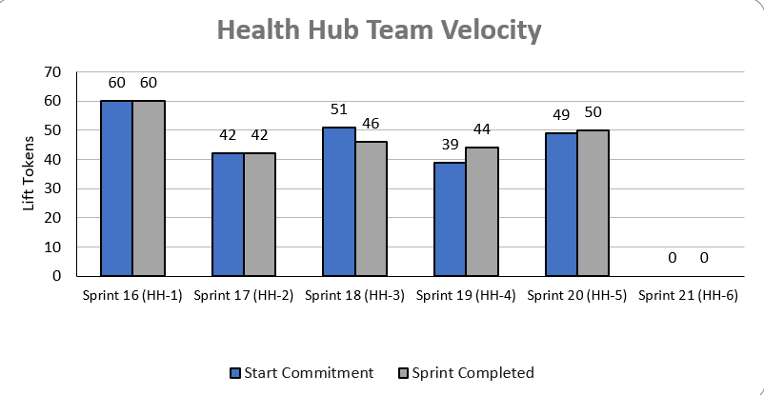
Health Hub Team velocity
 | Velocity details Velocity estimated in story points, using Fibonacci Velocity in Sprint 5 accounted for 7 team members 50 total story points were completed; Team committed to 49 story points at beginning of the sprint. 2 Stories added (6) mock-ups of text / PDF concepts for accessibility of MVP 4 stories blocked (0) pending IRS accessibility solution 1 story blocked (5) prototyping hypothesis pending analysis and synthesis of caregiver cohort in IA treejack testing
06-28 Sprint 5 Demo
Appendix
28

Slide 30
C
Lorem
User Story: Lorem
User Story: Lorem
User Story: Lorem
User Story: Lorem
User Story: Lorem
Lorem
Lorem
Lorem
Lorem
Lorem
Lorem
Lorem
Link
06-14 Sprint 4 Demo
Health Hub
30

Slide 31
A
Lorem
User Story: Lorem
User Story: Lorem
User Story: Lorem
User Story: Lorem
User Story: Lorem
Lorem
Lorem
Lorem
Lorem
Lorem
Lorem
Lorem
Link
06-14 Sprint 4 Demo
Lorem
31

Slide 32
C
m
User Story: Lorem
User Story: Lorem
User Story: Lorem
User Story: Lorem
User Story: Lorem
Lorem
Lorem
Lorem
Lorem
Lorem
Lorem
Lorem
Link
06-14 Sprint 4 Demo
1095-B
32

Slide 33
2
DESIGN
Lorem
User Story: Lorem
User Story: Lorem
Lorem
Lorem
Link
05-03 Sprint 1 Demo
Design
33

Slide 34
A
Lorem
User Story: Lorem
User Story: Lorem
Lorem
Lorem
Link
05-31 Sprint 3 Demo
Health Hub
34

Slide 35
2
DESIGN
Lorem
User Story: Lorem
User Story: Lorem
Lorem
Lorem
Link
05-03 Sprint 1 Demo
Design
35

Slide 36
3
PRODUCT
Lorem
User Story: Lorem
User Story: Lorem
Lorem
Lorem
Link
05-03 Sprint 1 Demo
Product
36

Slide 37
1
TECH
Lorem
User Story: Lorem
User Story: Lorem
User Story: Lorem
User Story: Lorem
User Story: Lorem
Lorem
Lorem
Lorem
Lorem
Lorem
Lorem
Lorem
Link
05-03 Sprint 1 Demo
Tech
37

Slide 38
2
DESIGN
Lorem
User Story: Lorem
User Story: Lorem
Lorem
Lorem
Link
05-03 Sprint 1 Demo
Design
38

Slide 39
2
DESIGN
Lorem
User Story: Lorem
User Story: Lorem
Lorem
Lorem
Link
05-03 Sprint 1 Demo
Design
39

Slide 40
3
PRODUCT
Lorem
User Story: Lorem
User Story: Lorem
Lorem
Lorem
Link
05-03 Sprint 1 Demo
Product
40

Slide 41
D
Lorem
User Story: Lorem
User Story: Lorem
User Story: Lorem
User Story: Lorem
User Story: Lorem
Lorem
Lorem
Lorem
Lorem
Lorem
Lorem
Lorem
Link
06-14 Sprint 4 Demo
1095-B
41

Slide 42
Sprint 1 will run April 20 to May 3rd
Owned by design team
Owned by product/ engineering team
Release
WE ARE HERE
SPRINT 1
SPRINT 2
SPRINT 3
SPRINT 4
SPRINT 5
Week 1: 04/20 – 04/26
Week 2: 04/27 – 05/03
Week 3: 05/04 – 05/10
Week 4: 05/11- 05/17
Week 5: 05/18 – 05/24
Week 6: 05/25 – 05/31
Week 7: 06/01 – 06/07
Week 8:
06/08 – 06/14
Week 9: 06/15-06/21
Week 10: 06/22-06/28
Product & Delivery
1095-B: Identify Change Management or Communications Plan
1095-B: Legal Review
1095-B: Handover plan - Prepare for launch
1095-B: Opt-in follow up
1095-B: Spanish translation docs
HH: Charter
HH: Develop backlog + Vision Framework
HH: Roadmap
User Experience & Design
1095-B: Wayfinding plan
Testing prep & recruiting
Voice of Veteran
Voice of Veteran
HH: Discovery
HH: Stakeholder Interviews
HH: Current State Journey Map
Prioritized plan
Engineering & Development
HH: Tech discovery
HH: Stakeholder Interviews
HH: Proposed tech integrations based off research findings
Collaboration Cycle
Midpoint Review
1095-B: Launch Date Dependent on Legal Review Completion
Research Plan Review
Research Plan Review
*Does not show post-MVP Validate phase meetings in Collaboration Cycle, such as Full Accessibility Audit and Post-Launch Check In; Contact Center Review adjusted to 3 weeks before launch as approved by Jason Woodman
Preview of Sprint 7

